Slide 1
Science Skills
Biology Unit #1

Slide 2
Science Skills Guided Notes
https://docs.google.com/document/d/12guyH4tzi77BCW0gt1ZllOD06liuh_9k0e5iIAuRSWo/edit?usp=sharing

Slide 3
What this unit covers
Observation vs Inference
Scientific Method
Variables
Interpreting Graphs and Tables
Science Fair Prep

Slide 4
Guided Quiz
Please answer #1-2.

Slide 5
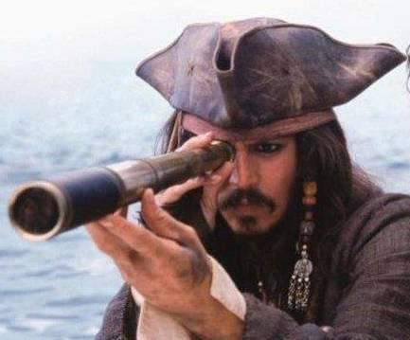
What does it mean to observe?

Slide 6
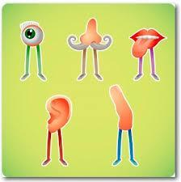
Observation
In science, and observation is anything experienced with the senses.

Slide 7
Observation
In science, and observation is anything experienced with the senses.
This includes things heard, smelt, felt, or tasted, rather than just saw.

Slide 8
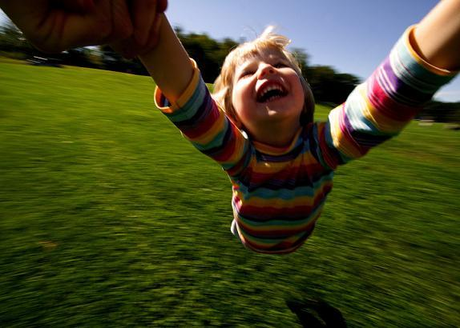
Inference

Slide 9
Inference
An inference is something you don't observe, but you know it's true because of what you do observe.

Slide 10
Why scientists make inferences
Will we ever see the core of the earth?
Will we ever see a black hole?
Will we ever see the edge of the universe?
Do doctors actually see the virus that causes the flu?
Has anyone ever seen an atom?

Slide 11
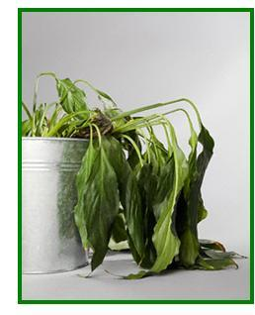
Examples
Observation: The plant is wilted

Slide 12
Examples
Observation: The plant is wilted
Inferences:
The plant hasn't had enough water
The plant will die
The person taking care of the plant is lazy

Slide 13
Guided Quiz
Please answer #3-4.

Slide 14
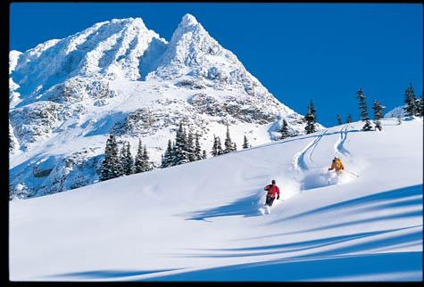
Your Turn: What observations can you make?

Slide 15
Your Turn: What inferences can you make?

Slide 16
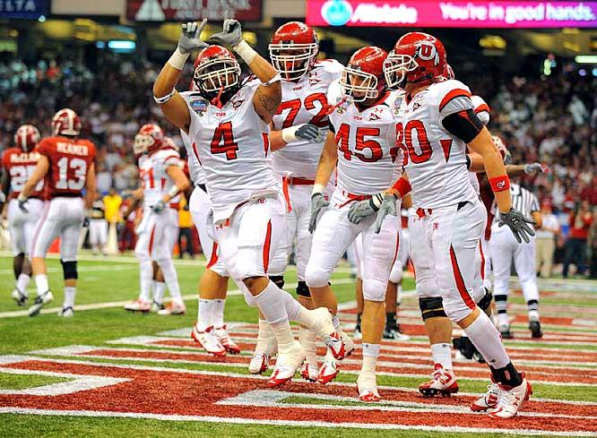
Your Turn: What observations can you make?

Slide 17
Your Turn: What inferences can you make?

Slide 18
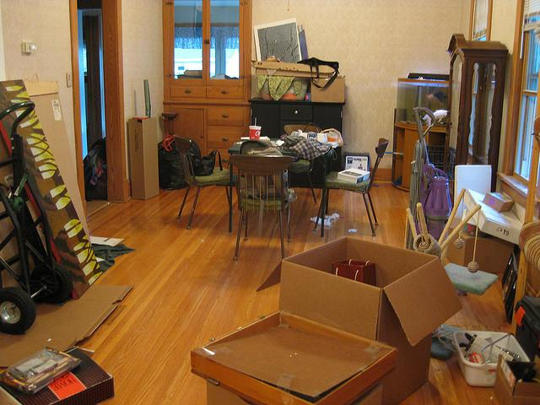
Your Turn: What observations can you make?

Slide 19
Your Turn: What inferences can you make?

Slide 20
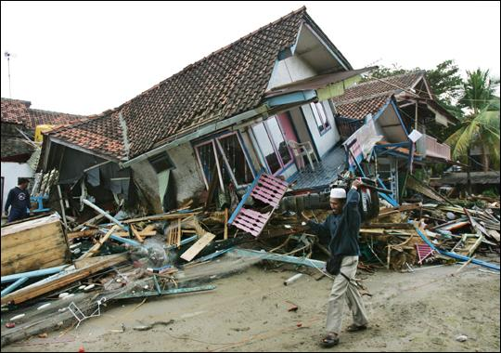

Slide 21
Competition: Guided Quiz #5

Slide 23
Activities
Scientific Method BDA (time permitting)
https://docs.google.com/document/d/1X-72KGTCX2hyBRE0yhupq7G_F_FikjPCABSQsORvm2U/edit?usp=sharing
https://docs.google.com/document/d/1LY_alO1JIgoefedJ1mfMUHQgpNDuzwoZ8IUV_IJsUqA/edit?usp=sharing

Slide 24
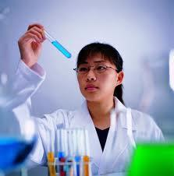
Experiments
What is an experiment?

Slide 25
Experiments
What is an experiment?
Are scientists the only people who do experiments?

Slide 26
Experiments
What is an experiment?
Are scientists the only people who do experiments?
Why do people do experiments?

Slide 27
Guided Quiz
Please answer #6-8

Slide 28
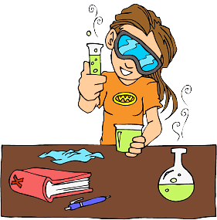
Today's Topic: How to Perform a Good Experiment

Slide 29
Today's Topic: How to Perform a Good Experiment
Poorly performed experiments often lead people to incorrect conclusions, as seen in the following example.

Slide 30
Start at 7:40

Slide 31
Two Big Questions!
Why do we perform experiments? To gain information.
Why do experiments have to be done properly? Our world demands accurate information.

Slide 32
A good experiment has five things:
Independent variable
Dependent variable
Control group
Treatment group
Large sample size

Slide 33
A good experiment has five things:
Independent variable
Dependent variable
Control group
Treatment group
Large sample size
If you enter the science fair, simply having a project with each of these five things will give you a good chance of winning.

Slide 34
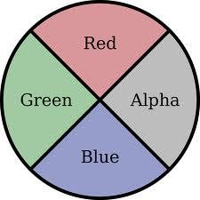
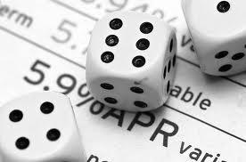
Before we jump in...
What does “vary” mean?

Slide 35
Before we jump in...
What does “vary” mean?
A variable is something that varies, or in other words, something that changes.

Slide 36
What does "independent" mean?

Slide 37
What does "independent" mean?
"Independent" means "not depending on anything else."

Slide 38
What does "independent" mean?
"Independent" means "not depending on anything else."
The independent variable is a variable that the experimenter has control over.

Slide 39
What does "independent" mean?
"Independent" means "not depending on anything else."
The independent variable is a variable that the experimenter has control over.
The independent variable is a variable (anything that changes) that doesn’t depend on the dependent variable, seen next.

Slide 40
What does "dependent" mean?
"Dependent" means "relying on something else."

Slide 41
What does "dependent" mean?
"Dependent" means "relying on something else."
In an experiment, the dependent variable is a variable that depends on the independent variable.
Put more simply, the dependent variable is the experimenter’s results.

Slide 42
The boss of a small company thinks that a special juice will increase the productivity of workers. He creates two groups of 50 workers each and assigns each group the same task (in this case, they're supposed to staple a set of papers). Group A is given the special juice to drink while they work. Group B is not given the special juice. After an hour, the boss counts how many stacks of papers each group has made. Group A made 1,587 stacks, Group B made 2,113 stacks.

Slide 43
Treatment Group
The treatment group is a group you experiment on that is changed in some way. It is the group given a new treatment of some kind.

Slide 44
Treatment Group
The treatment group is a group you experiment on that is changed in some way. It is the group given a new treatment of some kind.
What is the treatment group in the juice experiment?

Slide 45
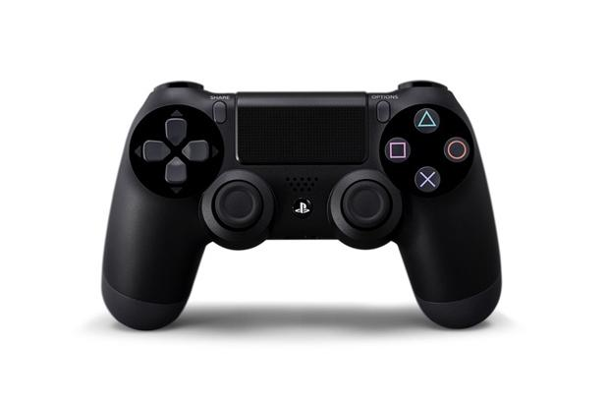
Does anyone know what a control is in an experiment?

Slide 46
Does anyone know what a control is in an experiment?
A control is a group you experiment on that you LEAVE THE SAME AS IT NORMALLY IS.

Slide 47
Does anyone know what a control is in an experiment?
A control is a group you experiment on that you LEAVE THE SAME AS IT NORMALLY IS.
Another way of looking at it: a control is a group that you don't apply any type of treatment to.

Slide 48
Does anyone know what a control is in an experiment?
A control is a group you experiment on that you LEAVE THE SAME AS IT NORMALLY IS.
Another way of looking at it: a control is a group that you don't apply any type of treatment to.
What is the purpose of a control?

Slide 49
Does anyone know what a control is in an experiment?
A control is a group you experiment on that you LEAVE THE SAME AS IT NORMALLY IS.
Another way of looking at it: a control is a group that you don't apply any type of treatment to.
What is the purpose of a control?
A control is used so that we have something to compare the treatment group to.

Slide 50
An example of why we need a control group.
You love playing Call of Duty. You want to know if playing while standing up will increase the number of flags to are able to capture.

Slide 51
An example of why we need a control group.
You love playing Call of Duty. You want to know if playing while standing up will increase the number of flags to are able to capture.
You play Call of Duty for one hour, during which time you capture eight flags.

Slide 52
An example of why we need a control group.
You love playing Call of Duty. You want to know if playing while standing up will increase the number of flags to are able to capture.
You play Call of Duty for one hour, during which time you capture eight flags.
Can you conclude that standing up while playing Call of Duty increases the number of flags you capture?

Slide 53
A better experiment
After playing Call of Duty for an hour while standing up, you play again while sitting down as you normally do. You capture 15 flags.
Does it appear that standing up while playing Call of Duty lets you capture more flags?
This experiment is now much better, but we STILL can’t conclude that playing Call of Duty while standing up helps. Why?

Slide 54
The boss of a small company thinks that a special juice will increase the productivity of workers. He creates two groups of 50 workers each and assigns each group the same task (in this case, they're supposed to staple a set of papers). Group A is given the special juice to drink while they work. Group B is not given the special juice. After an hour, the boss counts how many stacks of papers each group has made. Group A made 1,587 stacks, Group B made 2,113 stacks.

Slide 55
Answers
Independent variable: what type of juice the workers got.
Dependent variable: how many papers were stapled
Control group: Group B (the group that is left alone)
Conclusion: The juice didn't work, and likely made workers less productive
If Group A had worked outside and Group B had worked inside, this experiment would not be valid because it wouldn't be controlled. Only ONE variable can be changed in an experiment (only one manipulated variable).

Slide 56
Find the Variables!
A prankster was told that a certain itching powder, Itcheroo was the best thing on the market. It claims to cause 50% longer lasting itches. Interested in this product, the prankster buys the itching powder and compares it to his usual product. One test subject is sprinkled with the original itching powder, and another test subject is sprinkled with Itcheroo. The subject given the original powder reported having itches for 30 minutes. The subject given Itcheroo reported having itches for 45 minutes.

Slide 57
Find the Variables!
Mr. Lloyd wants to know if students will perform better on their next biology test if he offers to give money to students who earn an A. In secret, he offers half of the class twenty dollars if they get an A. He makes no offer to the other half of the class. After Mr. Lloyd grades the tests, he finds that the students who were offered money averaged a 90% on the test. The students who were not offered money averaged an 80%.

Slide 58
Activities
Experiments #1
ACT Discussion
Practice ACT Science

Slide 59
Review
Match the terms with their definitions
Independent Variable | Whatever you leave the same as it normally is
Dependent Variable | Whatever you apply the new treatment to
Control Group | The thing that the experimenter controls, or changes.
Treatment Group | The results of an experiment.

Slide 60
A boy wants to know if eating chili peppers affects thinking speed. He makes three of his family members eat chili peppers and then times how fast they can solve twenty multiplication problems. He has three other family members take the same test without having eaten chili peppers first. He finds that the family members that ate the peppers took an average of 35 seconds to finish the test. Those that didn't eat the peppers took an average of 45 seconds.

Slide 61
Let's See How Much You Know!
What is the independent variable?
What is the dependent variable?
What is the control group?
What is the treatment group?
Can the boy conclude that eating chili peppers increases thinking speed? Why or why not?

Slide 62
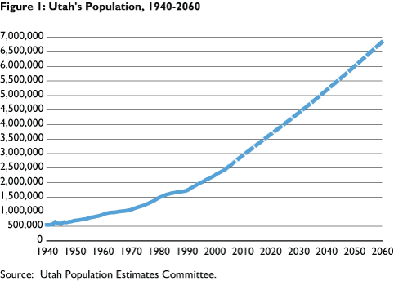
Today’s Topic: Sample Size and Graphing

Slide 63
Gertrude wants to know if a new brand of laundry detergent removes stains better than the current brand she uses. She washes a stained white shirt at her friend's house in a washer she's never used before. After the wash, she finds that all the stains are gone.
Gertrude concludes that the new brand of laundry detergent works much better than the current brand she uses.
Explain why Gertrude will NOT be winning the science fair.

Slide 64
Gertrude’s Big Problem
Gertrude has TWO independent variables. BAD GERTRUDE!!!

Slide 65
Gertrude’s Big Problem
Gertrude has TWO independent variables. BAD GERTRUDE!!!
In other words, Gertrude changed two separate things.
The brand of laundry detergent
The washing machine

Slide 66
Gertrude’s Big Problem
Gertrude has TWO independent variables. BAD GERTRUDE!!!
In other words, Gertrude changed two separate things.
The brand of laundry detergent
The washing machine
Gertrude doesn’t know which made her shirt clean: the brand of detergent, or the new washing machine.

Slide 67
Oh Gertrude, Why?
Gertrude ALSO has no control group. In your own words, why is this a problem?

Slide 68
Oh Gertrude, Why?
Gertrude ALSO has no control group. In your own words, why is this a problem?
Guided Quiz #9-10.

Slide 69
Review
Mrs. Pay wants to know if students can read faster if they listen to music while they read. She has all her students read a section from Ender’s Game. Three students listen to no music, three listen to classical music, three listen to heavy metal music, and three listen to country music.

Slide 70
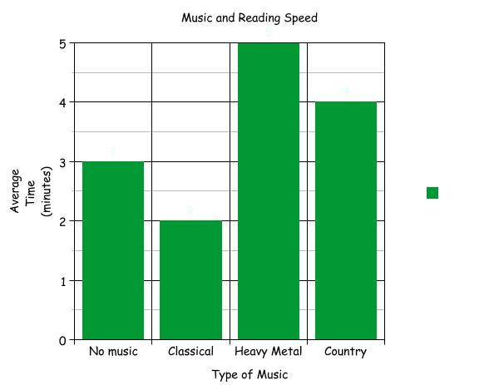

Slide 71
Review
What is the independent variable?
What is the dependent variable?
What is the control?
What is the treatment group?

Slide 72
The Big Question!
Can Mrs. Pay conclude for sure that listening to classical music is better than no music, heavy metal, or country for improving reading speed?

Slide 73
Mrs. Pay Makes Some Changes….
Mrs. Pay wants to know if students can read faster if they listen to music while they read. She makes everyone on Earth read a section from Ender’s Game. 2 billion people, chosen randomly, listen to no music, 2 billion listen to classical music, 2 billion listen to heavy metal music, and 2 billion listen to country music.

Slide 74
Not very realistic, but….
Explain in your own words why this experiment involving everyone on Earth gives a more reliable conclusion than the previous experiment done with Mrs. Pay’s students.

Slide 75
Sample Size
Sample size is how many individuals are in your treatment group and your control group.

Slide 76
Sample Size
Sample size is how many individuals are in your treatment group and your control group.
Why are results invalid if an experimenter lacks a large sample size?

Slide 77
Sample Size
Sample size is how many individuals are in your treatment group and your control group.
Why are results invalid if an experimenter lacks a large sample size?
Having a large sample size reduces the likelihood that your results are due to chance.

Slide 78
The Three Science Fair Pitfalls. BEWARE!!!
Students lack a control group.
Students don't have a sufficiently large sample size.
Students have more than one independent variable.

Slide 79
One More Practice
Guided Quiz #11-14

Slide 80
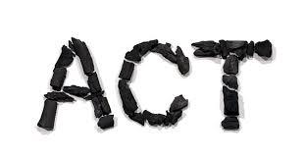
Lets Look at More Graphs!
Throughout Biology, we will look at graphs, charts, and tables and interpret them.

Slide 81
Lets Look at More Graphs!
Throughout Biology, we will look at graphs, charts, and tables and interpret them.
Why? Because the ACT includes lots of graphs and the ACT is a critically important part of your future.

Slide 82
A New Experiment
Mr. Lloyd asks students how long they studied after they complete a biology test.

Slide 83
A New Experiment
Mr. Lloyd asks students how long they studied after they complete a biology test.
He then grades the students’ tests and calculates the average score for students that studied for different amounts of time.

Slide 84
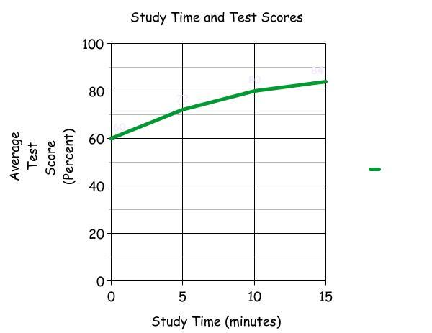

Slide 85
A few things to know about graphs:
The independent variable always goes in the x axis (along the bottom).

Slide 86
A few things to know about graphs:
The independent variable always goes in the x axis (along the bottom).
The dependent variable always goes in the y axis (on the left).

Slide 87
A few things to know about graphs:
The independent variable always goes in the x axis (along the bottom).
The dependent variable always goes in the y axis (on the left).
Graphs make the results of an experiment easy to see.

Slide 88
Practice
What is the independent variable?

Slide 89
Practice
What is the independent variable?
What is the dependent variable?

Slide 90
Practice
What is the independent variable?
What is the dependent variable?
Students who studies for 0 minutes averaged what score?

Slide 91
Practice
Students who studied for 15 minutes averaged what score?

Slide 92
Practice
Students who studied for 15 minutes averaged what score?
Complete the sentence: as study time increases, test scores ______.

Slide 93
A New Experiment
Doctors want to know if increasing the amount of vegetables people eat will increase their lifespan.

Slide 94
A New Experiment
Doctors want to know if increasing the amount of vegetables people eat will increase their lifespan.
The doctors ask thousands of patients to report on how many servings of vegetables they eat a day.

Slide 95
A New Experiment
Doctors want to know if increasing the amount of vegetables people eat will increase their lifespan.
The doctors ask thousands of patients to report on how many servings of vegetables they eat a day.
The doctors track the patients for fifty years.

Slide 96
A New Experiment
Doctors want to know if increasing the amount of vegetables people eat will increase their lifespan.
The doctors ask thousands of patients to report on how many servings of vegetables they eat a day.
The doctors track the patients for fifty years.
Doctors then determine the average lifespan for people that ate different amounts of vegetables.

Slide 97
BEFORE WE LOOK AT THE GRAPH….
What will we find along the x axis (the bottom of the graph)?
What will we find along the y axis (the left of the graph)?

Slide 98
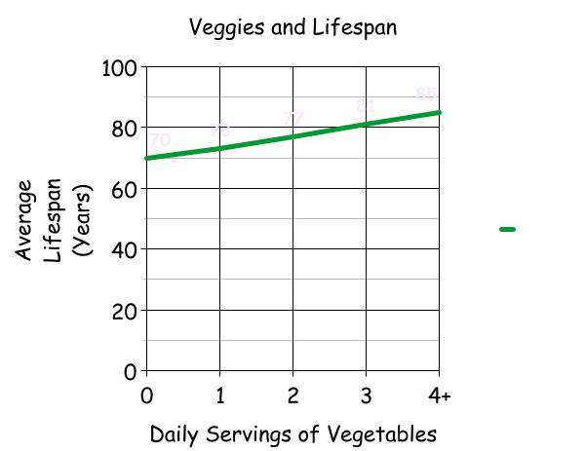

Slide 99
Practice
How long, on average, does a person who eats no vegetables live?

Slide 100
Practice
How long, on average, does a person who eats no vegetables live?
Does this mean that nobody who doesn’t eat vegetables lives past age 70?

Slide 101
Practice
How long, on average, does a person who eats four servings of vegetables live for?

Slide 102
Practice
How long, on average, does a person who eats four servings of vegetables live for?
What do you think the doctors concluded?

Slide 103
Guided Quiz
Please answer #15-17.

Slide 104
Activity
Introduction to Graph Interpretation

Slide 105
Remember the Three Science Fair Pitfalls!!!
Students lack a control group.
Students don't have a sufficiently large sample size.
Students have more than one independent variable so their experiment is not controlled.
Gertrude made all three of these mistakes. How can she improve her experiment?

Slide 106
Gale wants to know what type of food will best attract Blue Jays.
Gale gets four bird feeders. Into one, he puts a cup of bread crumbs. Into another, he puts five cups of worms. Into another, he puts three sunflower seeds. Into the last, he puts two pounds of nectar.
Gale puts the feeder with bread crumbs near a beautiful waterfall. He puts the feeder with worms in the town commons. He puts the feeder with sunflower seeds near a deadly volcano. He puts the feeder with nectar inside his bedroom.
Gale watches the bird feeders with hidden cameras for 24 hours and finds that 100 blue jays visited the bird feeder with bread crumbs. No blue jays visited any of the other feeders.

Slide 107
Test Review
Important! This test review includes going over the answers to your guided quizzes. In future units, you will need to have you guided quizzes completed when you come to class on the day of a test.

Slide 108
Test Review
Important! This test review includes going over the answers to your guided quizzes. In future units, you will need to have you guided quizzes completed when you come to class on the day of a test.
Remember--guided quizzes are 20% of your grade.

Slide 109
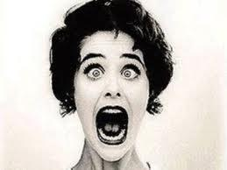
DON’T CALL ON ME!!
How many of you feel like this inside when called on to answer a question?

Slide 110
DON’T CALL ON ME!!
How many of you feel like this inside when called on to answer a question?
Remember: research proves that randomly calling on students significantly improves learning.

Slide 111
DON’T CALL ON ME!!
How many of you feel like this inside when called on to answer a question?
Remember: research proves that randomly calling on students significantly improves learning.
If you don’t know a question, we will help you until you can give the correct answer.

Slide 112
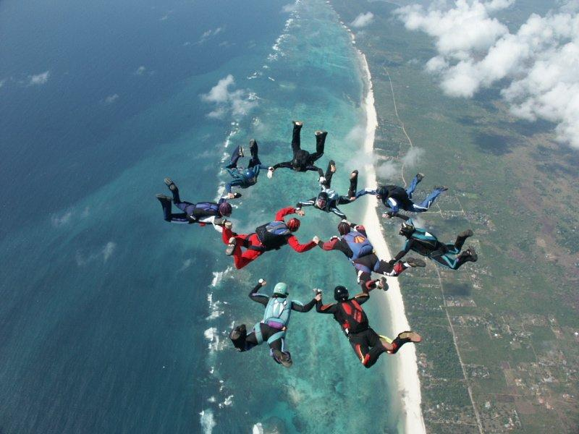

Slide 113
Review
What are some observations you can make?
What are some inferences you can make?
Answer #1-4 in the guided quiz if you haven’t already.

Slide 114
Jack Sparrow wants to know which sails will make the Black Pearl, his pirate ship, sail the fastest. He tests three different types of sails: His usual sails, 100% cotton sails, and 100% polyester sails.
In the evening, he sails from Tortuga to Pelegosto using his regular sails. It takes him three hours. The next morning, he sails from Pelegosto back to Tortuga using the 100% cotton sails. It takes him eight hours. Then, in the afternoon, he sails from Tortuga back to Pelegosto using the 100% polyester sails. It takes him two hours and fifty-nine minutes.

Slide 115
What are some things that Jack has done wrong? #6-8 in the guided quiz.
Jack Sparrow wants to know which sails will make the Black Pearl, his pirate ship, sail the fastest. He tests three different types of sails: His usual sails, 100% cotton sails, and 100% polyester sails.
In the evening, he sails from Tortuga to Pelegosto using his regular sails. It takes him three hours. The next morning, he sails from Pelegosto back to Tortuga using the 100% cotton sails. It takes him eight hours. Then, in the afternoon, he sails from Tortuga back to Pelegosto using the 100% polyester sails. It takes him two hours and fifty-nine minutes.

Slide 116
Independent variable, dependent variable, control, and treatment group
Henry notices that his shower is covered in a strange green slime. His friend tells him that coconut juice will get rid of the green slime. Henry decides to check this out by spraying half of the shower with coconut juice every morning. He sprays the other half of the shower with water each morning. After 3 days, there is no change in the appearance of the green slime on either side of the shower.

Slide 117
Review
Independent variable- the thing you have control over.
Dependent variable- your results (what you look for).
Control- something you test on that you leave the same as it normally is.
Treatment group- something you test on that you change in some way.

Slide 118
Independent variable, dependent variable, control, and treatment group
Henry notices that his shower is covered in a strange green slime. His friend tells him that coconut juice will get rid of the green slime. Henry decides to check this out by spraying half of the shower with coconut juice every morning. He sprays the other half of the shower with water each morning. After 3 days, there is no change in the appearance of the green slime on either side of the shower.

Slide 119
Gatorade
A student wants to know if gatorade will make her run a mile faster. She runs from her house to the library, which is one mile, while drinking water. The next day, she runs from her school to the park, which is one mile, while drinking gatorade. Here are her results.

Slide 120
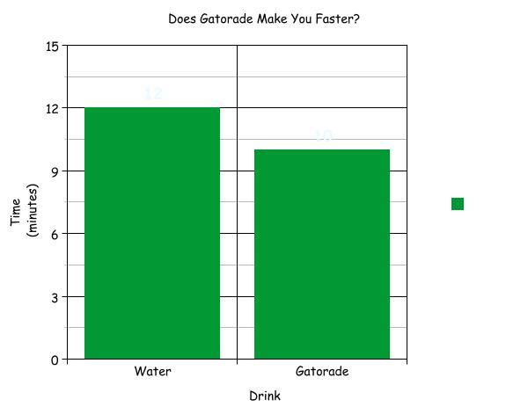

Slide 121
Almost Done!
What is the independent variable?
What is the dependent variable?
What is the control?
What is the treatment group?

Slide 122
Almost Done!
What is the independent variable?
What is the dependent variable?
What is the control?
What is the treatment group?
Can the student conclude that drinking gatorade makes her run faster? Why or why not?

Slide 123
Test
Science Skills Test

